Slide 1
Present continuous or progressive
What are they doing?

Slide 2

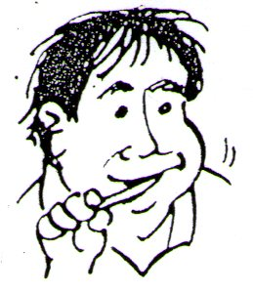
When do we use the present progressive or continuous?
What is he doing now?
1- To tell what people are doing at the moment.
To talk about something that is happening now, or at the moment of speaking.
He’s reading the newspaper
What is he doing now?
He is brushing his teeth.

Slide 3
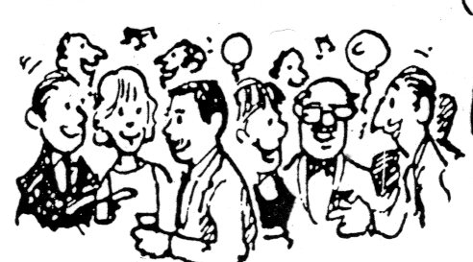
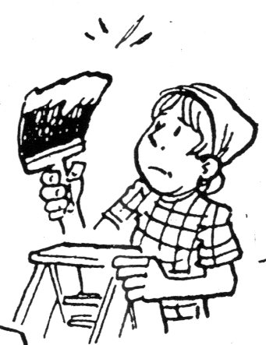
When do we use the present progressive or continuous?
They are having a big party.
3- We also use the present progressive to refer to things that are not exactly happening now but around now.
It also means that the action is in progress.
She is painting her house.

Slide 4
We form the present progressive tense by using:
Subject:
I
You
We
They
He
She
It
Verb be:
am
are
is
Verb:
eat
drink
dream
sleep
work
write
go
walk
+ ing
+ extra information

Slide 5
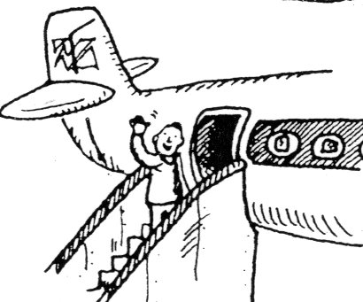
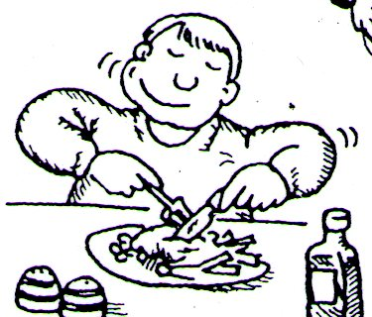

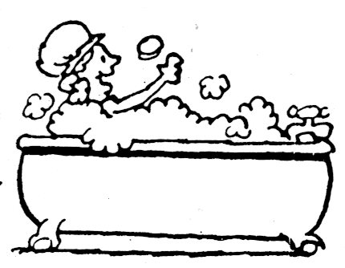
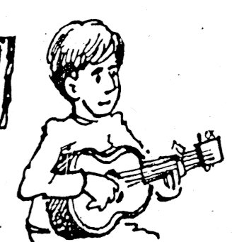
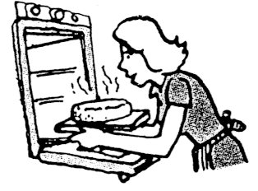
What are they doing?
He’s eating his lunch
Or
He’s having lunch.
He’s saying good-bye.
They are camping.
She’s taking a bath.
She’s baking a cake.
He’s playing the guitar.

Slide 6
Spelling rules:
Verb ends in: “consonant-vowel-consonant”.
S i t
( C+V+C)
Verbs ending in “e” – drop “e” and add “ing”
Take
write
Shake
Introduce
Make
Bake
Move
Taking
Writing
Shaking
Introducing
Making
Baking
Moving
Sit
Shop
Chop
Stop
Swim
Jog
Beg
Sitting
Shopping
Chopping
Stopping
Swimming
Jogging
Begging

Slide 7


Exceptions:
When they end in: w - x – y
When the verbs end in: w – x – y , you do not double the last letter.
Chew
Draw
Fix
Mix
Relax
Play
Study
Chewing
Drawing
Fixing
Mixing
Relaxing
Playing
Studying

Slide 8
if the verb has more than one syllable, and the final syllable is not stressed, we do not double the final letter.
travel
Visit
Open
Enter
Iron
TRA – vel
VI – sit
O – pen
EN – ter
I – ron
traveling
Visiting
Opening
Entering
Ironing

Slide 9
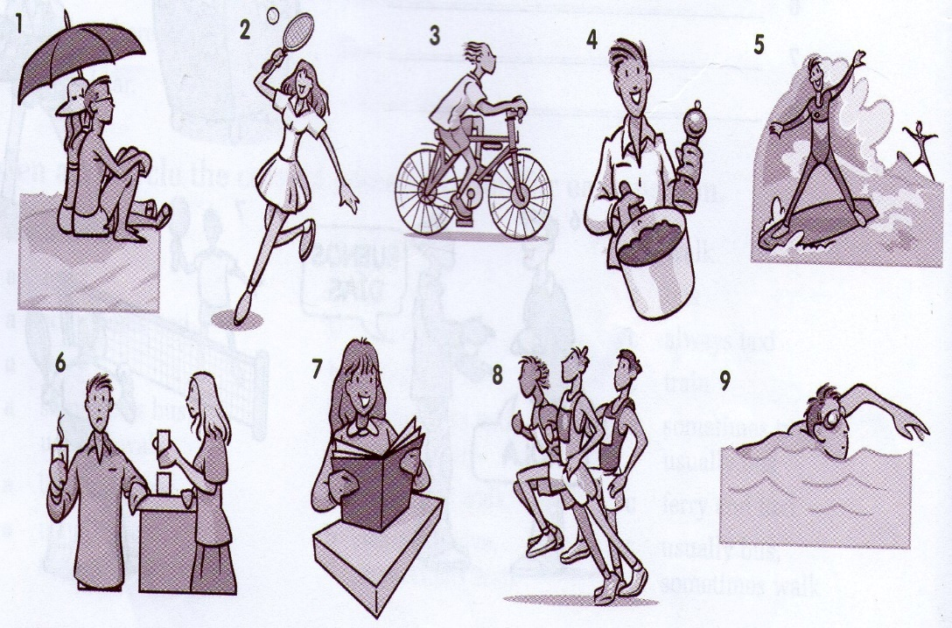
What are they doing?
1._______________
2 ._______________
3 ._______________
4 ._______________
5 ._______________
6 ._______________
7 ._______________
8 ._______________
9 ._______________
They are sitting on the beach.
She
He is riding his bike.
He
He is surfing at the beach.
They’re drinking coffee and talking.
She
They’re running in a marathon.
He

Slide 10
Stative verbs cannot be used in the progressive tense
- There are verbs that are NOT normally used in continuous tenses:
know
want
need
prefer
like
love
hate
believe
forget
remember
see
hear
understand
seem
mean
suppose
belong
realize
have (when the meaning is ‘possess’)
think (when the meaning is ‘believe’)
Stative verbs describe a state of being or a situation that does not change
Examples:
I am knowing you (incorrect)
I know you. (correct)
I am needing a book. (incorrect)
I need a book. (correct)
I am having a dog. (incorrect)
I have a dog. (correct)

Slide 11
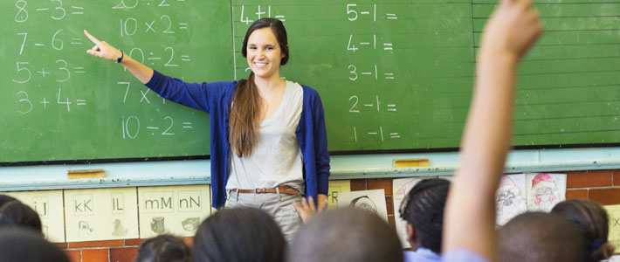
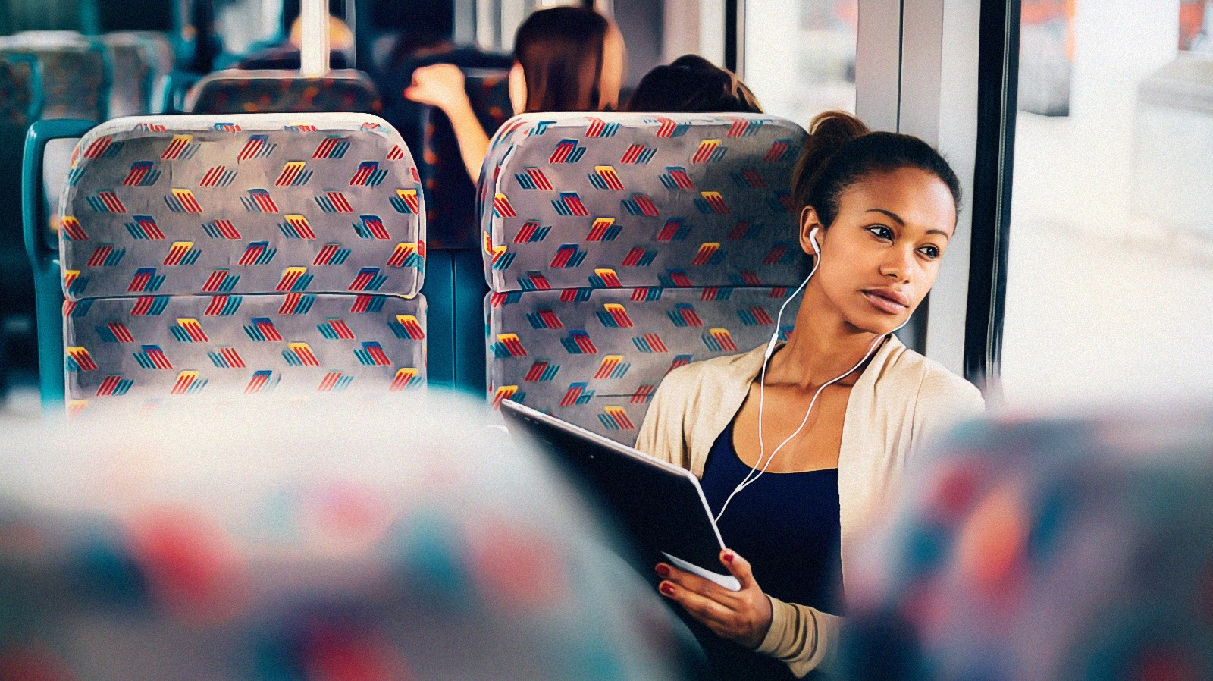
What are these people doing? (Actions happening around now)
She is teaching mathematics.
She is traveling by bus.

Slide 12

Let’s ask questions:
Yes / No questions

Slide 13
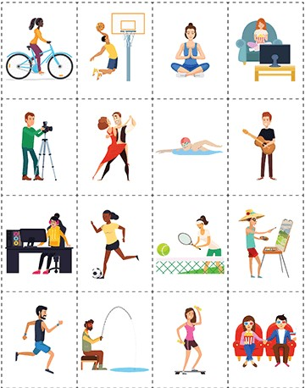
Are they dancing? –yes, they are. Is she eating a sandwich? –no, she isn’t.
Ride a bike.
Play basketball.
Do yoga.
Watch TV.
Take photographs.
Dance.
Swim.
Play the guitar.
Work on the computer.
Play soccer / tennis
Paint a picture.
Run / Jog.
Fish / go fishing.
Do aerobics.
Go to the cinema / go to the movies.

Slide 14

Let’s ask more questions:
Information questions

Slide 15
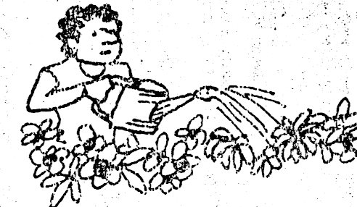
What are you doing today? –I’m working in the garden.
*What are you doing today? – I am resting.
Where are you resting?
– I am resting at home.
Why are you resting at home?
- Because it’s Sunday. I don’t work on Sundays.
It’s 2 pm. What are you doing?
- I’m watching TV.
What are you watching on TV?
- I’m watching a comedy.
Who are you watching a movie with?
- I’m watching a movie with my family.
What time are you having dinner?
- I’m having dinner at 6:30 pm.
What are you having for dinner?
- We’re having chicken soup.
Where are you having dinner?
. - I’m having dinner at home

Slide 16
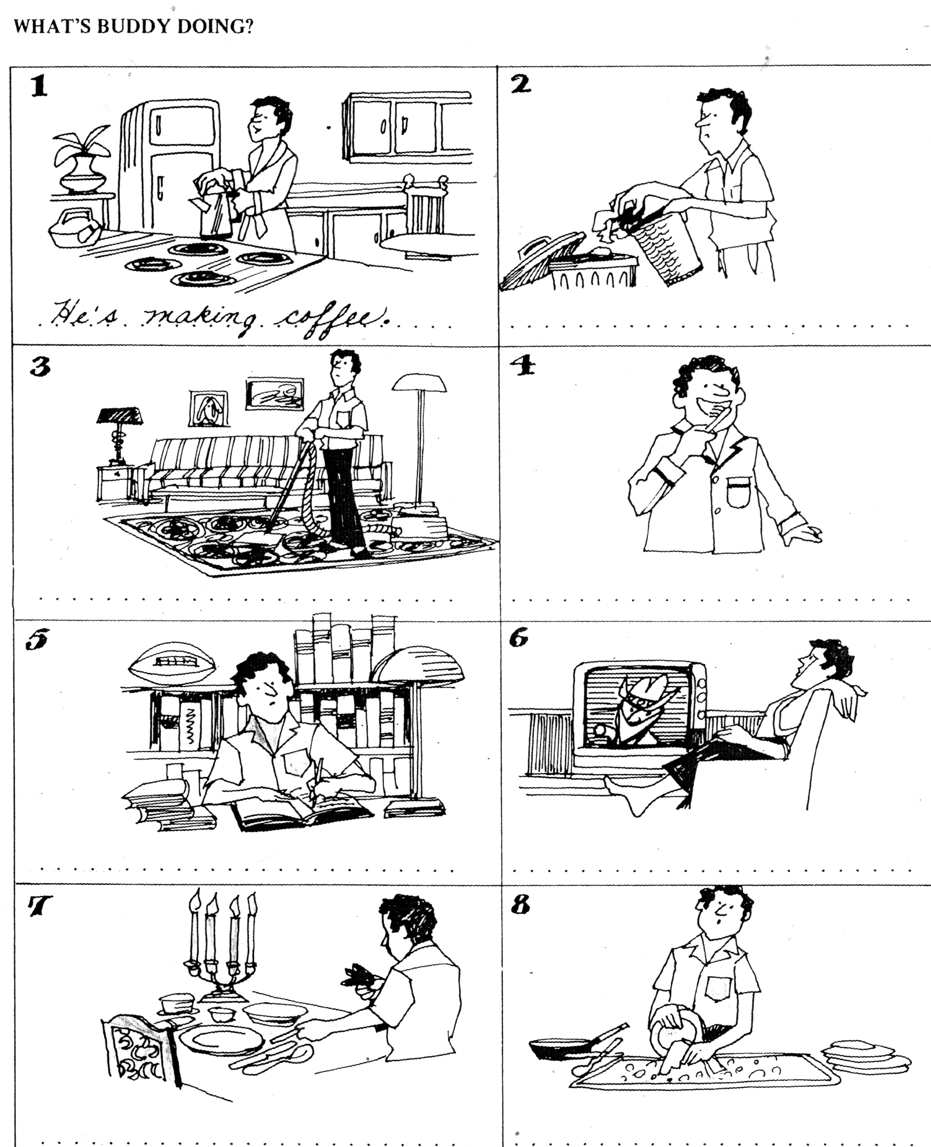
*What is buddy doing today? –He’s making coffee. *Where is he making coffee?... *Where…? What time…? When…? Who…? Why…?
Make coffee.
Make breakfast.
Throw away the garbage / trash.
Clean the house.
Vacuum the carpet.
Put on pajamas.
Brush *his teeth
Study for the exam.
Do homework.
Watch TV.
Watch a movie / a program.
Set the table for dinner.
Pick up the table.
Do the dishes.
*her / my / our

